Slide 1

Adhyayan NextGen Solutions Pvt. Ltd.
Expertise: Website & Software Development, Cloud Solutions, Cybersecurity
Services: School ERP |Inventory| CRM Software | Website & App Development
Office locations:
Head Office: Gurugram, Haryana
Branch Office: Neelbad, Bhopal

Slide 2


Adhyayan NextGen Solutions Pvt. Ltd.
Product overview
Log in management
Profile management
Admin management
Employee management
Referral|affiliate management
Report management
Online admission
Online exam management
Online study material
Dynamic website
Video lectures
Online attendance
Student management
Online fee Payment

Slide 3
Adhyayan NextGen Solutions Pvt. Ltd.
Why Choose Us?
Decades Of Experience In IT Solutions
Latest Technology and Tech Trends
Customize Solutions
Consistent Update And Maintenance Services
Cloud Based ERP Software Services

Slide 4
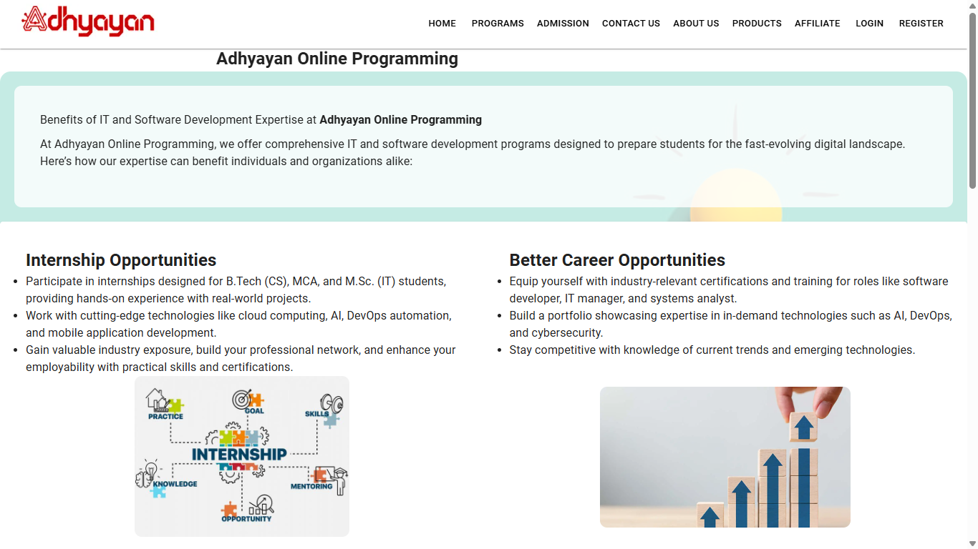
Adhyayan NextGen Solutions Pvt. Ltd.
Dynamic Website Features

Slide 5
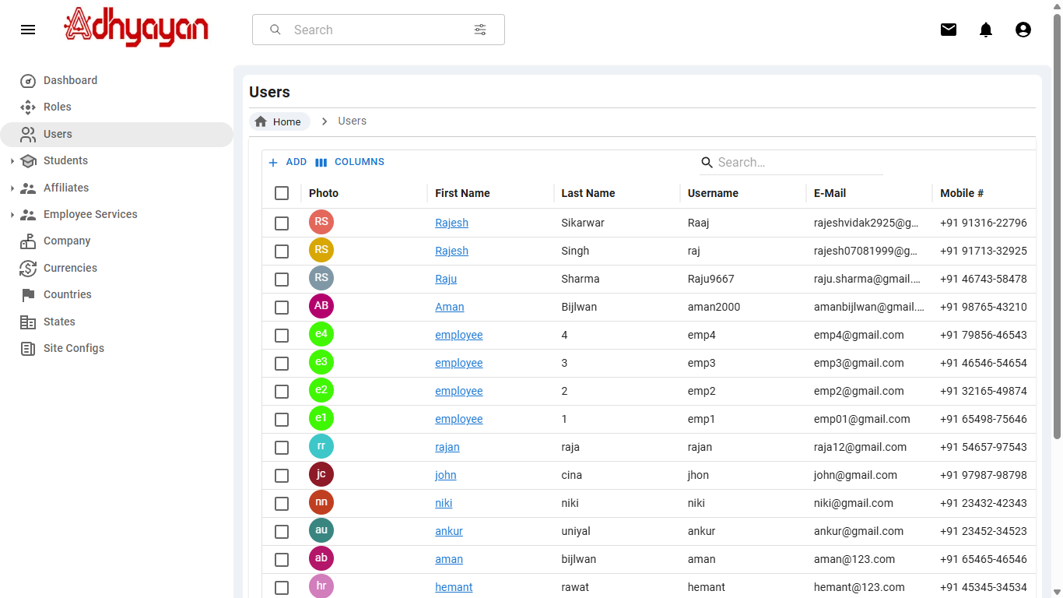
Adhyayan NextGen Solutions Pvt. Ltd.
Admin Dashboard

Slide 6
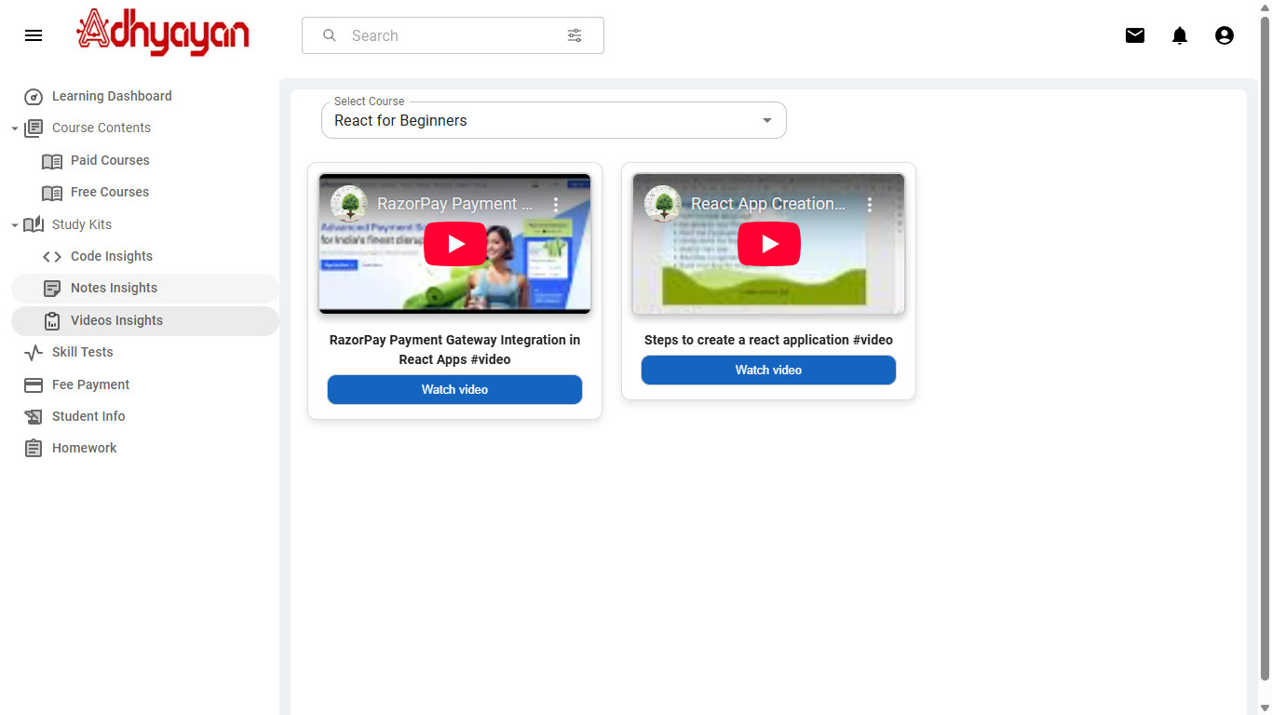
Adhyayan NextGen Solutions Pvt. Ltd.
Student Dashboard Features

Slide 7
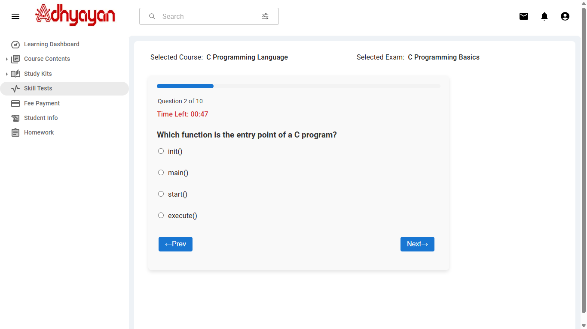
Adhyayan NextGen Solutions Pvt. Ltd.
Online Test

Slide 8
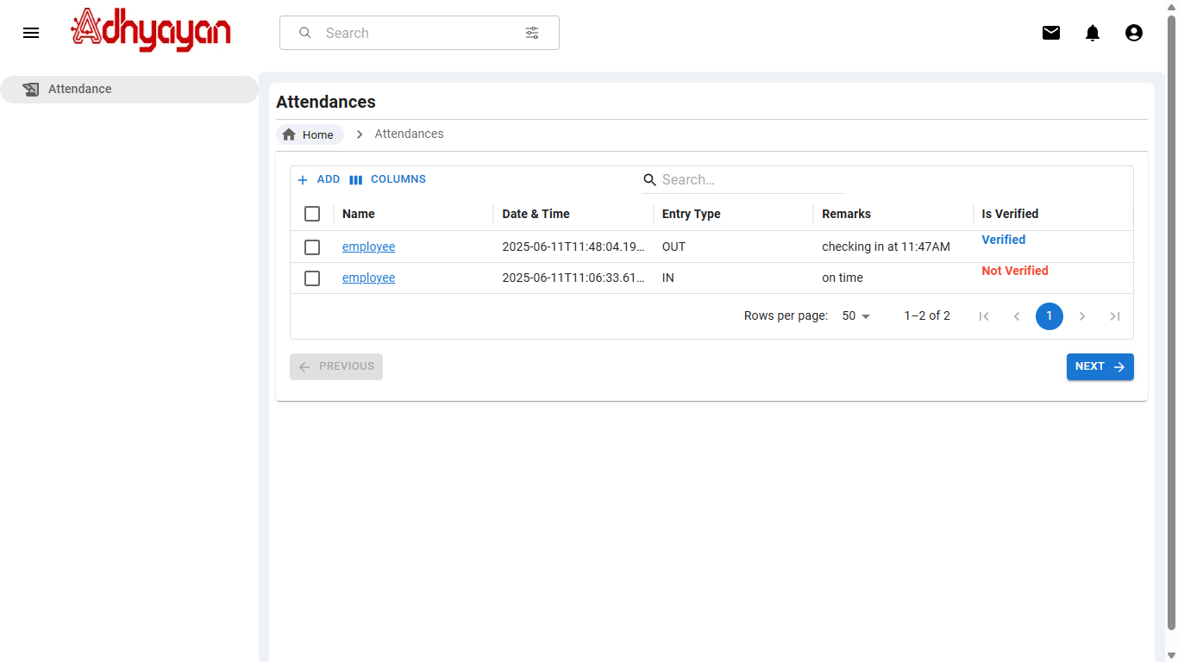
Adhyayan NextGen Solutions Pvt. Ltd.
Employee Dashboard Features

Slide 9
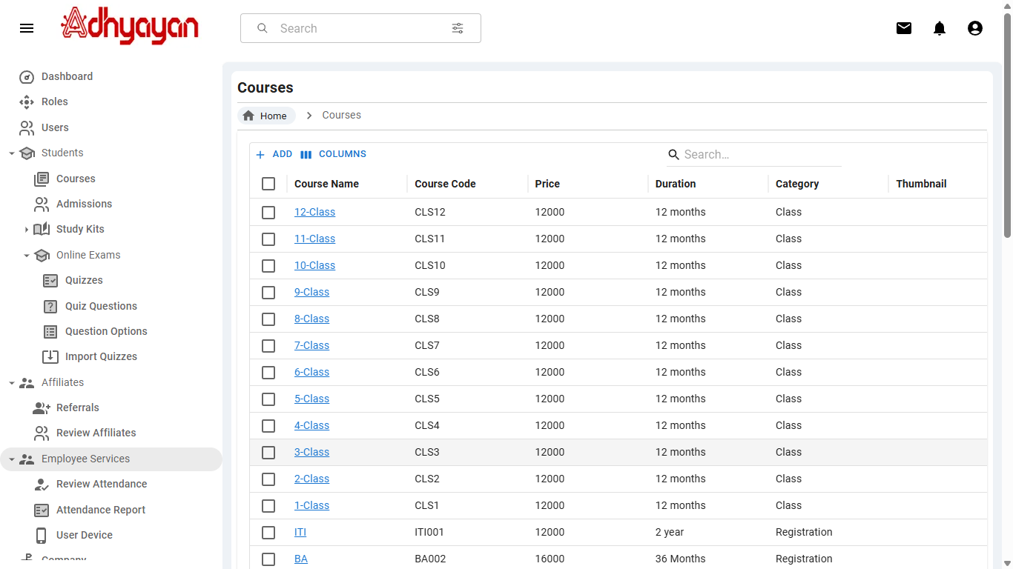
Adhyayan NextGen Solutions Pvt. Ltd.
Attendance Features Of Admin Dashboard

Slide 10
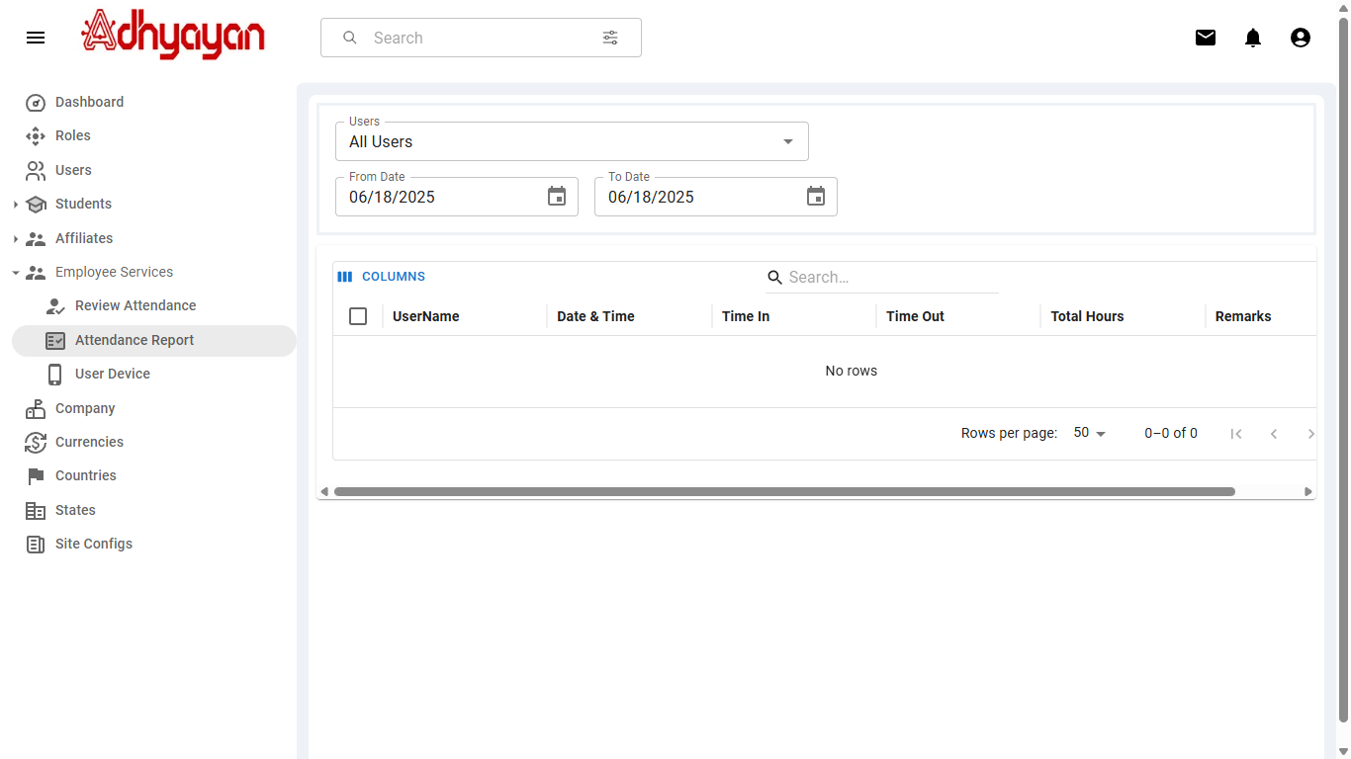
Adhyayan NextGen Solutions Pvt. Ltd.
Attendance Features Of Admin Dashboard
User Manual

Slide 11
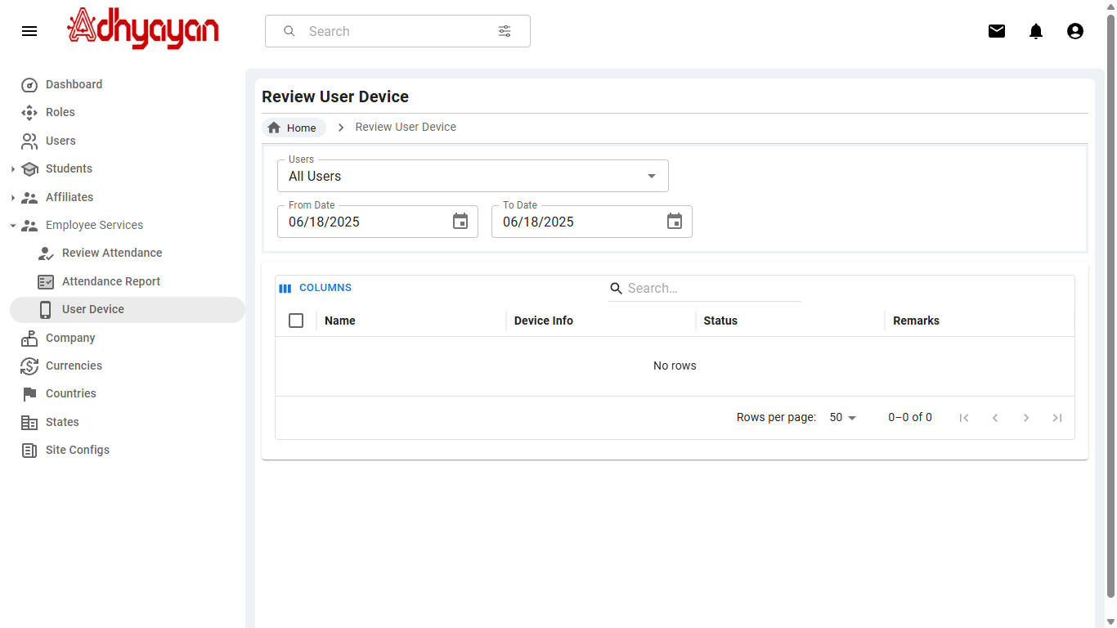
Adhyayan NextGen Solutions Pvt. Ltd.
Attendance Features Of Admin Dashboard

Slide 12
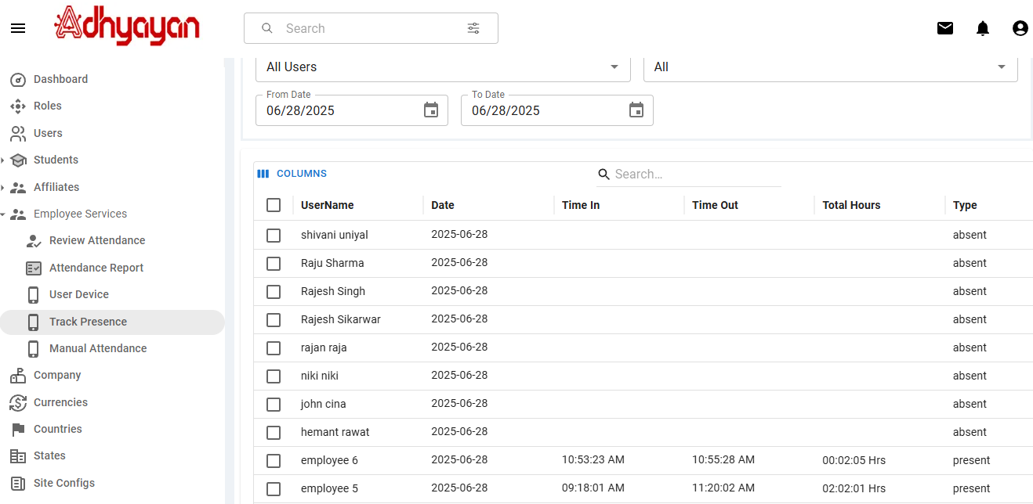
Adhyayan NextGen Solutions Pvt. Ltd.
Attendance Features Of Admin Dashboard

Slide 13
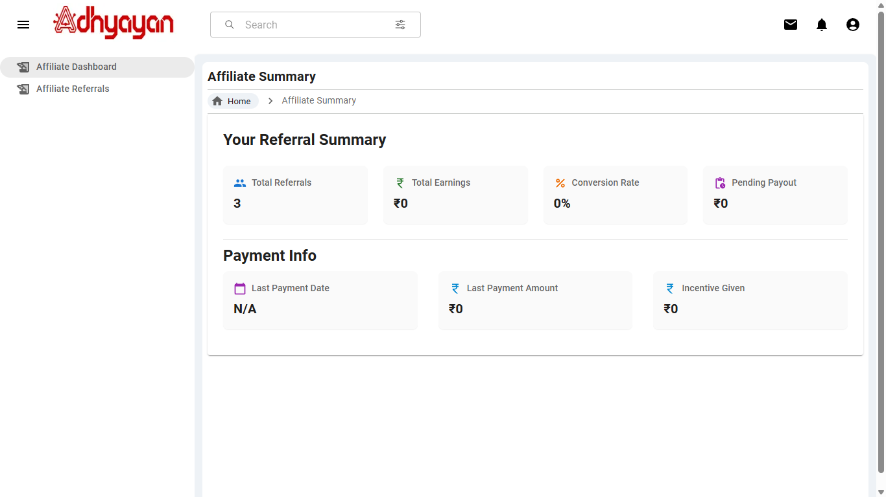
Adhyayan NextGen Solutions Pvt. Ltd.
Affiliate Dashboard Features

Slide 14
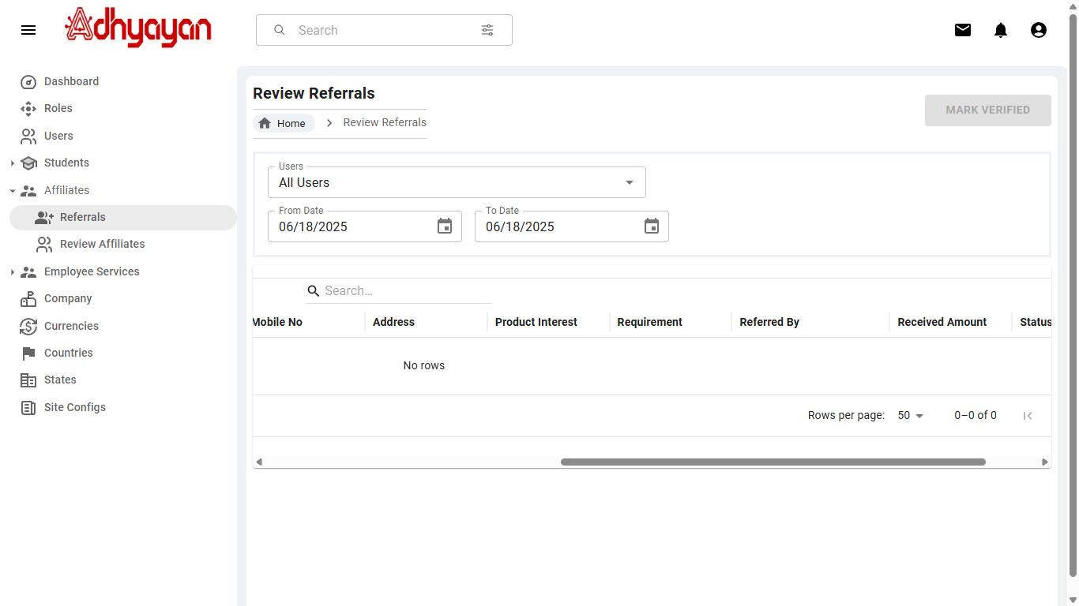
Adhyayan NextGen Solutions Pvt. Ltd.
Affiliate Features Of Admin Dashboard

Slide 15
T
Adhyayan NextGen Solutions Pvt. Ltd.
Thank You

